Slide 1
Responsible research conduct
Chris HJ Hartgerink
October 6, 2015
www.chjh.nl
@chartgerink

Slide 2
Who am I?

Slide 3
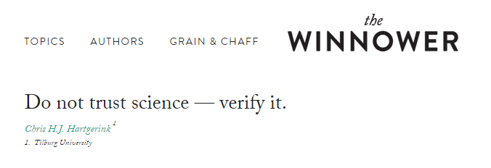
Who am I?

Slide 4
Interact during the workshop via ethics.pwall.nl

Slide 5
What are your beliefs about research practice?

Slide 6
Future standards will be set by our generation of PhDs

Slide 7
Falsification Fabrication Plagiarism

Slide 8
R C R
F F P

Slide 9
Responsible Conduct of Research

Slide 10
R C R
F F P

Slide 11
Teach what’s bad practice

Slide 12
BUT don’t teach what’s good practice

Slide 13
For example Plagiarism = not citing

Slide 14
Why do we cite?

Slide 15
RCR
Steneck, N. H. (2006). Fostering integrity in research: definitions, current knowledge, and future directions. Science and Engineering Ethics, 12(1), 53–74.

Slide 16
RCR
Research ethics
Research integrity
Steneck, N. H. (2006). Fostering integrity in research: definitions, current knowledge, and future directions. Science and Engineering Ethics, 12(1), 53–74.

Slide 17
RCR
Research ethics
Research behavior viewed from the perspectives of moral principles
Steneck, N. H. (2006). Fostering integrity in research: definitions, current knowledge, and future directions. Science and Engineering Ethics, 12(1), 53–74.

Slide 18
RCR
Research behavior viewed from the perspectives of professional standards
Research integrity
Steneck, N. H. (2006). Fostering integrity in research: definitions, current knowledge, and future directions. Science and Engineering Ethics, 12(1), 53–74.

Slide 19
Fabrication
Integrity: it goes against the standards
Ethics (example): if everyone would do this, science would break. Hence, it is unethical to do this.

Slide 20
Integrity
Setting clear standards for research practice
Top-down system
Matter of agreement at bureaucratic level
Unambiguous once agreed
Main question: HOW to determine?

Slide 21
Integrity
Ethics
Setting clear standards for research practice
Top-down system
Matter of agreement at bureaucratic level
Unambiguous once agreed
Main question: HOW to determine?
Highly ambiguous
Inspired by belief
Bottom-up approach
Normative
Persistent discussion

Slide 22
Virtue ethics:
Build scientific character

Slide 23
Character is defined in daily operations

Slide 24
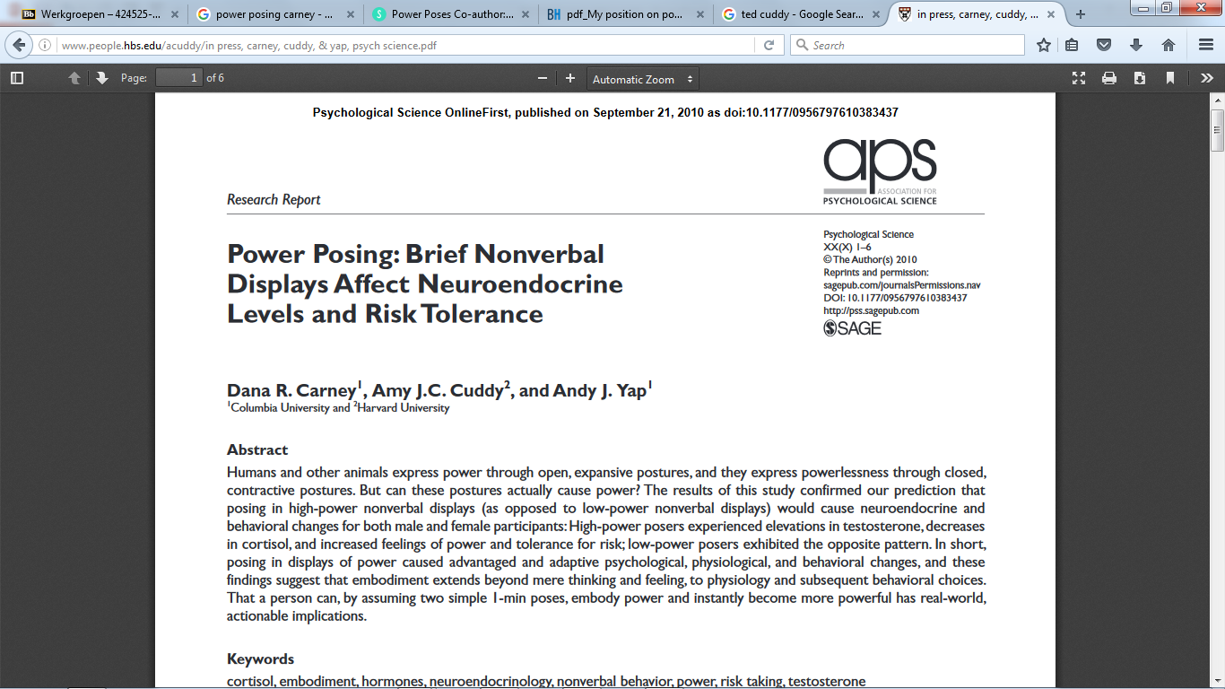

Slide 25
“Initially, the primary DV of interest was risk-taking. We ran subjects in chunks and checked the effect along the way. It was something like 25 subjects run, then 10, then 7, then 5. Back then this did not seem like p-hacking. It seemed like saving money (assuming your effect size was big enough and p-value was the only issue)”
- Carney, 2016

Slide 26
As evidence has come in over these past 2+ years, my views have updated to reflect the evidence. As such, I do not believe that “power pose” effects are real.
- Carney, 2016

Slide 27
Cases

Slide 28
How to deal with problems with uncertain outcomes?

Slide 29
Prospective decisions, but retrospective evaluations

Slide 30
Evaluate and discuss problems prospectively

Slide 31
Discuss and document WHY you make decisions

Slide 32
Daily operations include
Data sharing
Negative results
File drawer
Researcher bias (e.g., confirmation bias)
Sharing research materials
Making mistakes
Research documentation

Slide 33
Norm | Counternorm
Universalism | Particularism
Communality | Secrecy
Disinterestedness | Self-interestedness
Skepticism | Dogmatism
Governance | Administration
Quality | Quantity

Slide 34
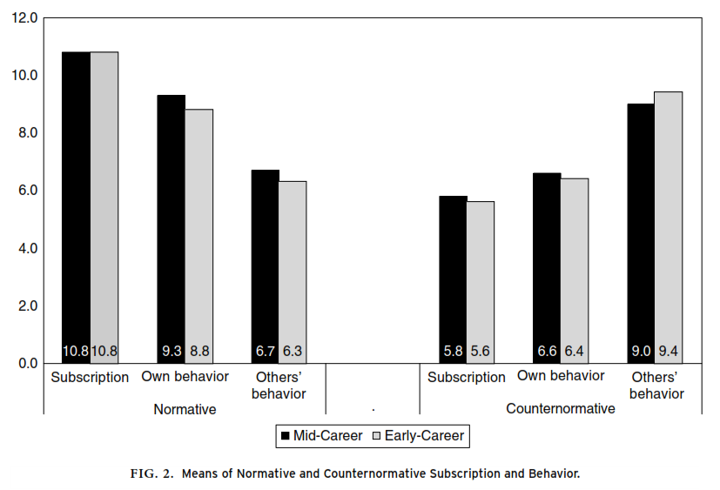

Slide 35
How do you compare?

Slide 36
Norm
Universalism
Communality
Disinterestedness
Skepticism
Governance
Quality
Transparency!

Slide 37
Norm
Universalism
Communality
Disinterestedness
Skepticism
Governance
Quality
Improved documentation

Slide 38
Norm
Universalism
Communality
Disinterestedness
Skepticism
Governance
Quality
Publicly share all findings

Slide 39
Norm
Universalism
Communality
Disinterestedness
Skepticism
Governance
Quality
Increased accountability

Slide 40
Norm
Universalism
Communality
Disinterestedness
Skepticism
Governance
Quality
Sharing research promotes verification

Slide 41
Norm
Universalism
Communality
Disinterestedness
Skepticism
Governance
Quality
Improved project management by researchers

Slide 42
Norm
Universalism
Communality
Disinterestedness
Skepticism
Governance
Quality
Increased quality as a consequence of other norms

Slide 43
Open Science Framework
Dropbox project folder

Slide 44
Open Science Framework
Dropbox project folder
Example

Slide 45
What to do when confronted with potential breaches?

Slide 46
Pubpeer example
Notes:
Show pubpeer website here for a short demo
Just go to the featured section
Especially helpful when it is OUTSIDE of your university

Slide 47
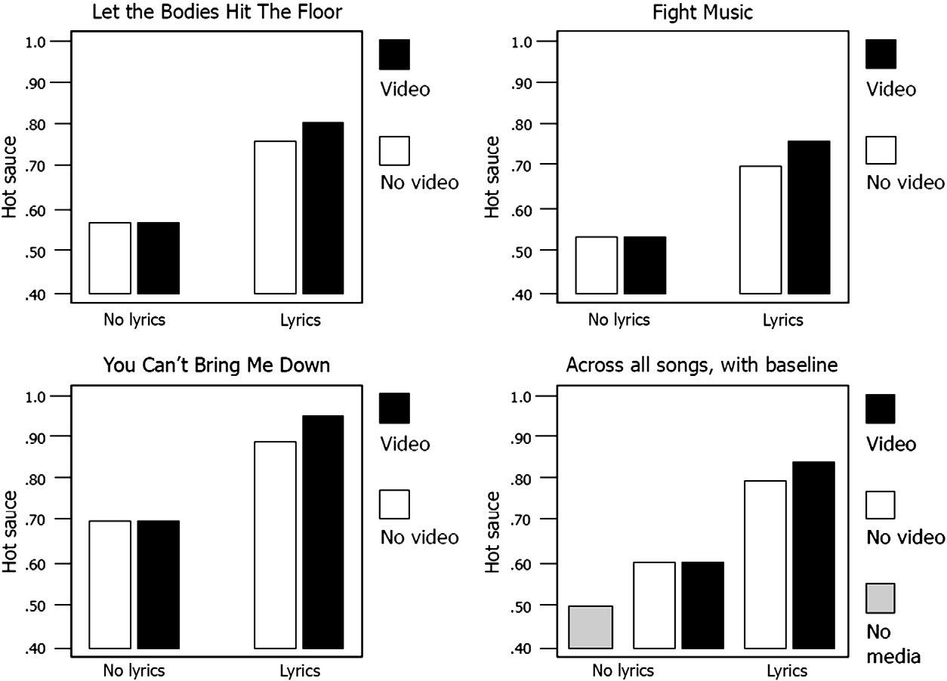
Pubpeer example

Slide 48
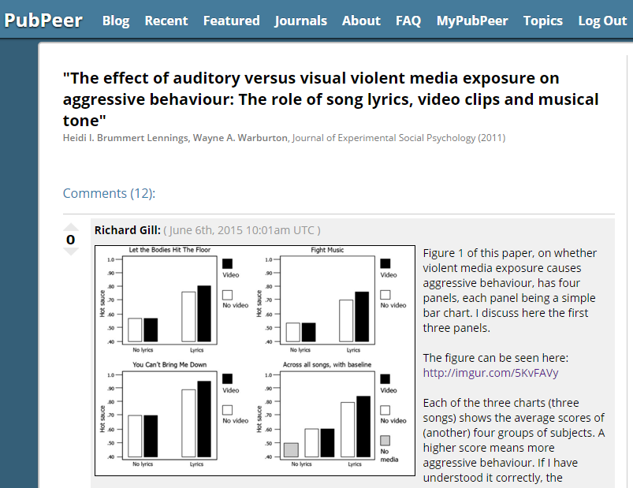
Posted on June 6th, 2015

Slide 49
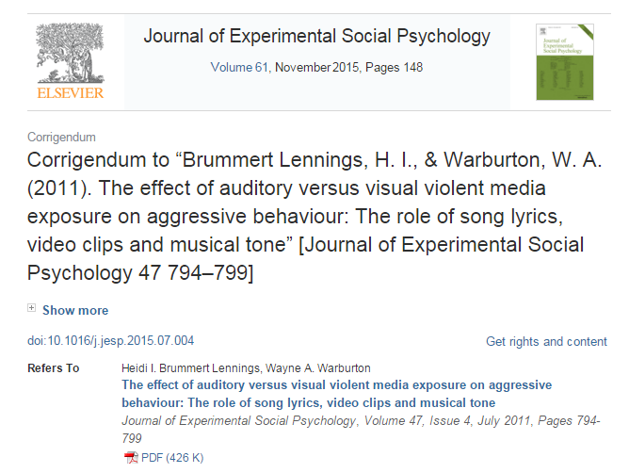
Posted ~August 12, 2015

Slide 50
Take aways
Ethics and integrity are very different
Ethics is a (daily!) struggle
Being transparent about your research is the easiest way to take responsibility, improve accountability, but also increase credibility
What is ethical is determined prospectively, taking into account potential outcomes, but not retrospectively. Decisions cannot and should not be evaluated purely on hindsight
Ethics not universal, so continuous discussion important

Slide 51
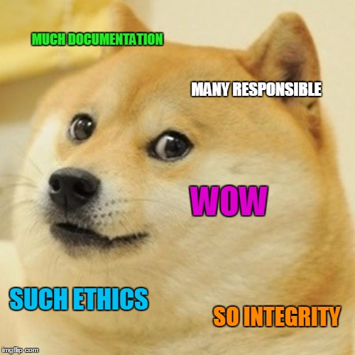

Slide 52
Anecdotes of your own?

